Slide 1
THE FRP MURAL
GARWARE CRICKET CLUB WANKHADE STADIUM MUMBAI
GFRC FACADES
MUMBAI – BANGLORE – CHENNAI – KERALA - GUJARAT

Slide 2
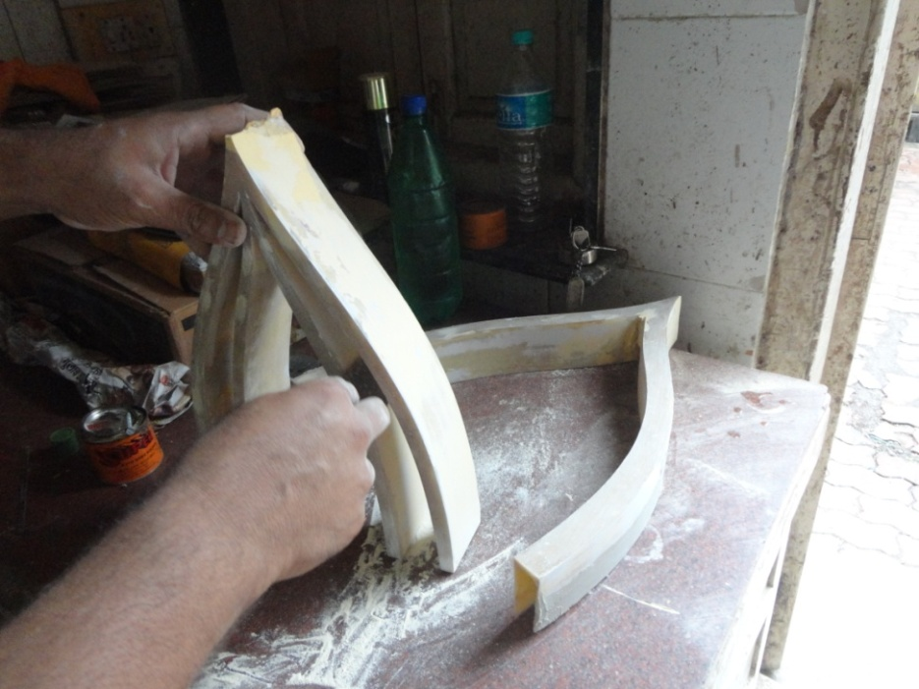
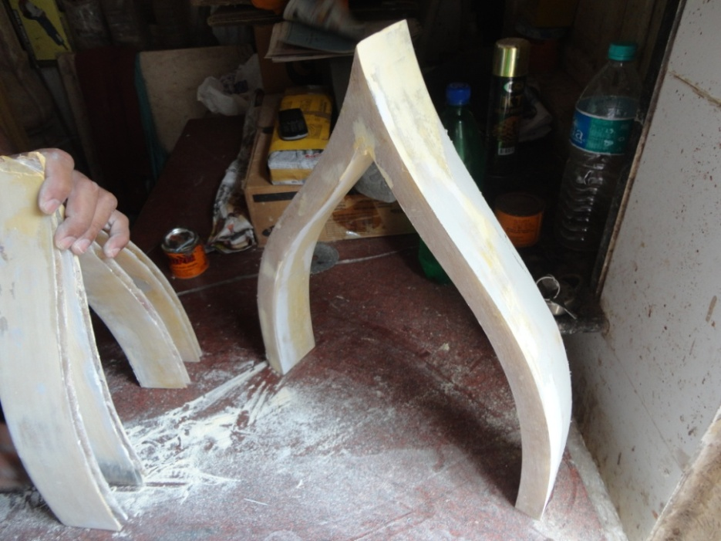
FRP MURAL
SAMPLE FOR APPROVAL OF THE DESIRED PROFILE CARVED IN WOOD

Slide 3
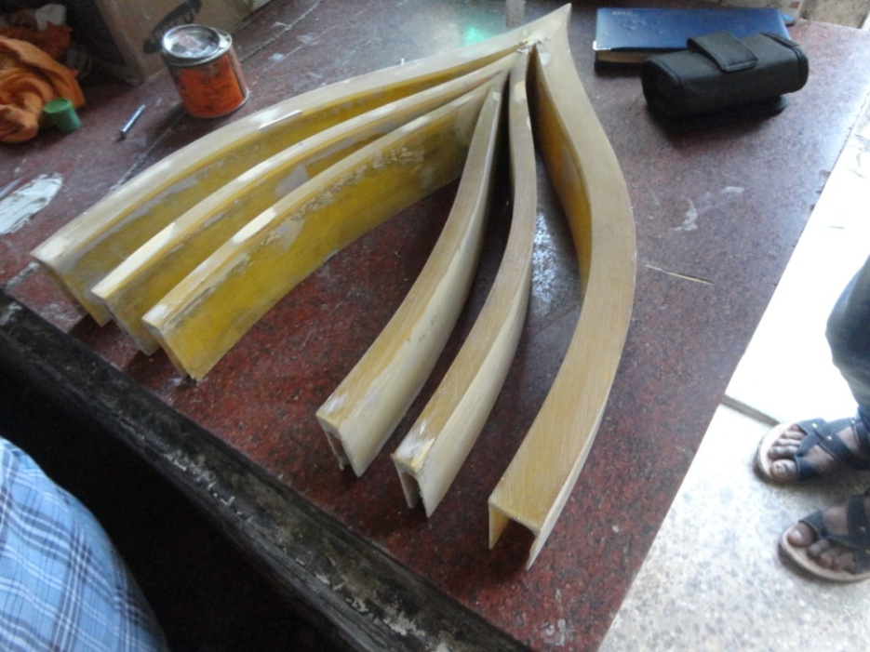
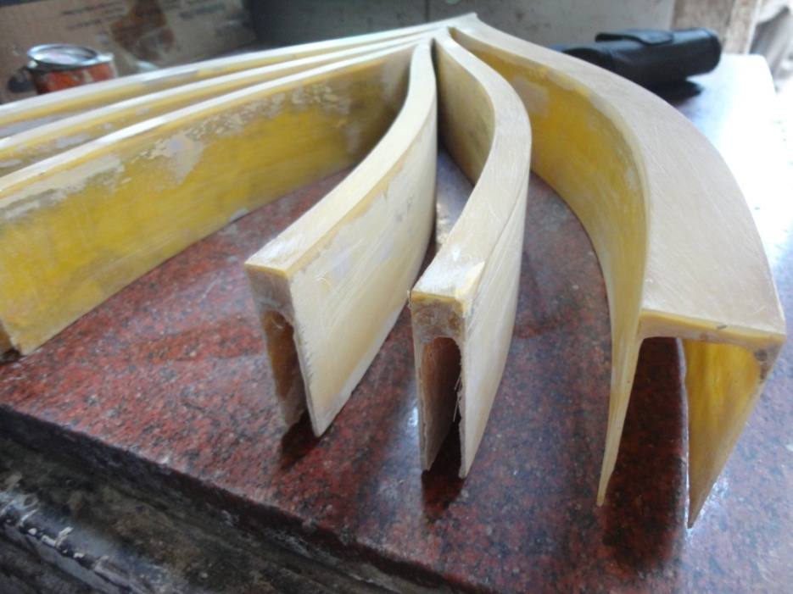
FRP MURAL
SAMPLE FOR APPROVAL OF THE DESIRED PROFILE

Slide 4
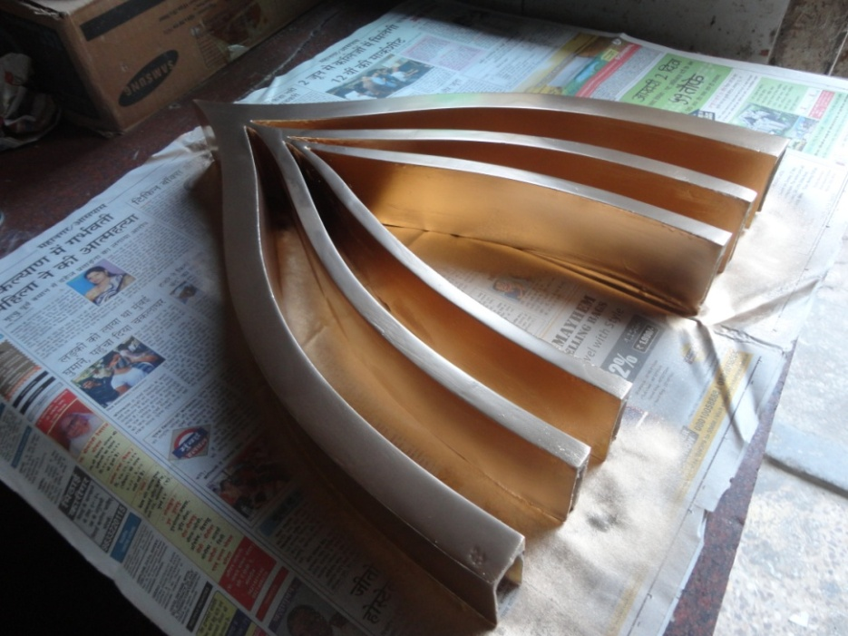
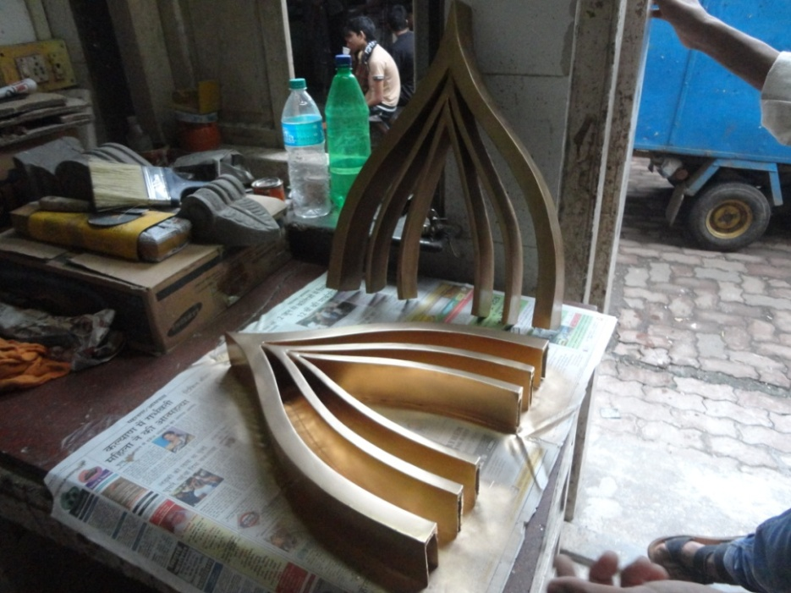
FRP MURAL WITH GOLDEN FINISH
SAMPLE FOR APPROVAL OF THE DESIRED PROFILE

Slide 5
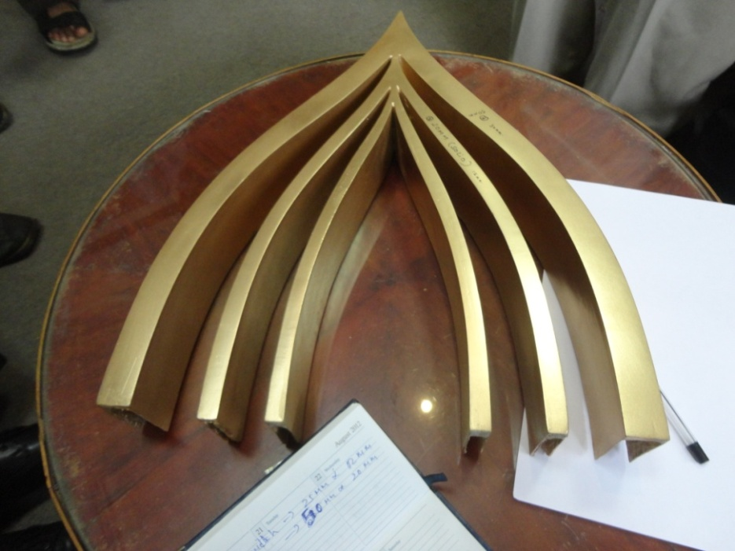
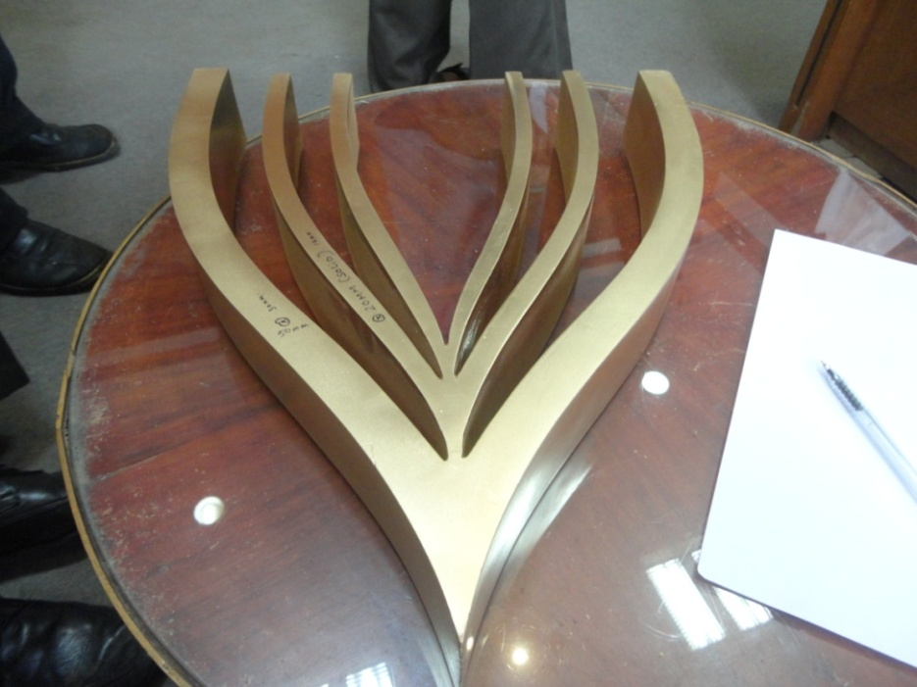
FRP MURAL WITH GOLDEN FINISH
SAMPLE FOR APPROVAL OF THE DESIRED PROFILE

Slide 6
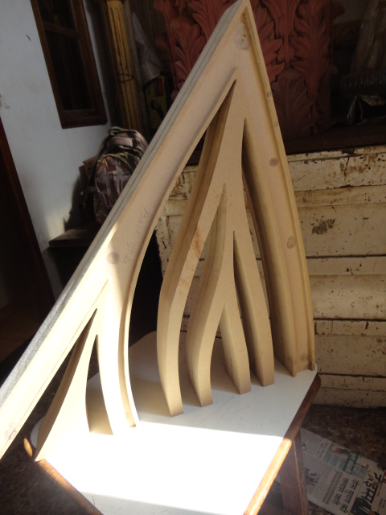
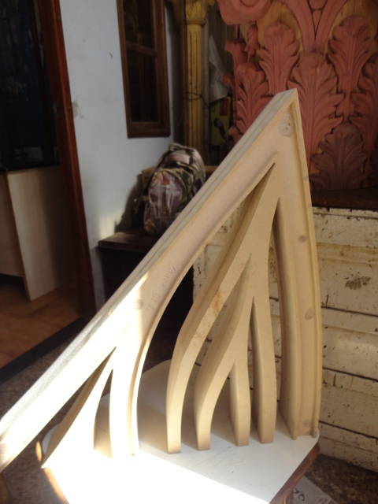
FRP MURAL
SAMPLE FOR APPROVAL OF THE DESIRED PROFILE IN WOOD

Slide 7
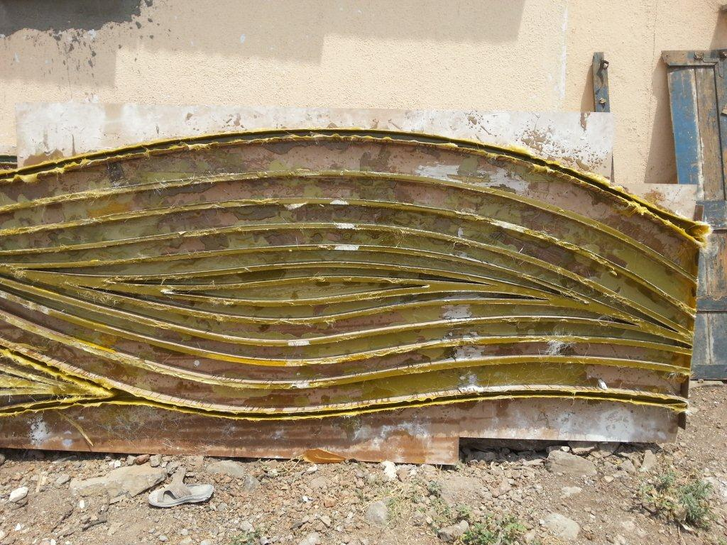
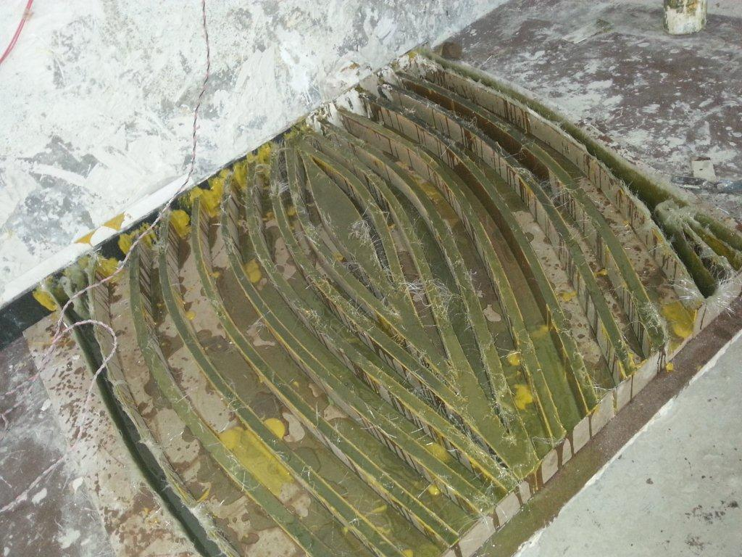
THE MOULD IN FRP

Slide 8
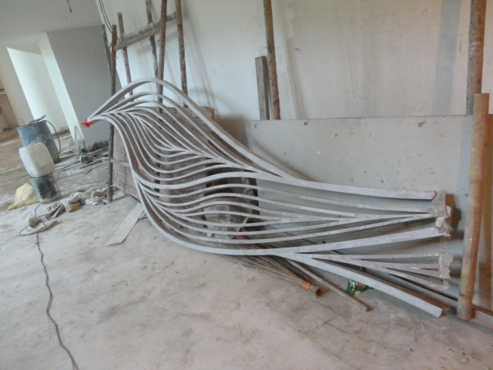
THE FINAL FRP ELEMENT AT SITE

Slide 9
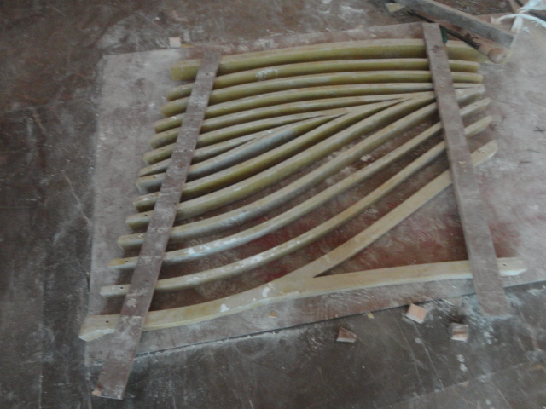
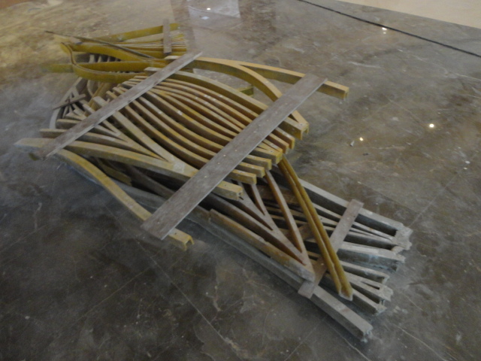
THE FINAL FRP ELEMENT AT SITE

Slide 10
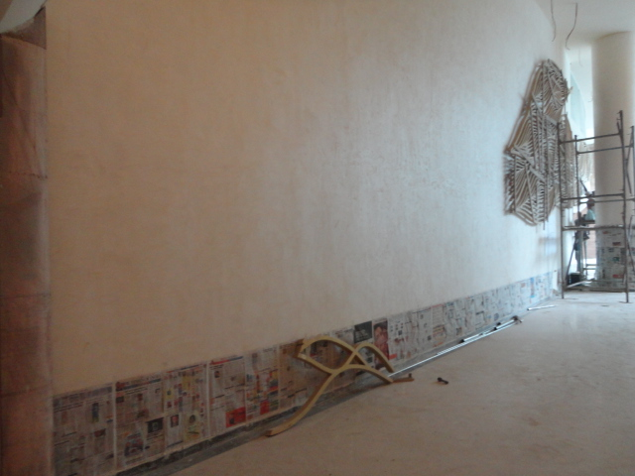
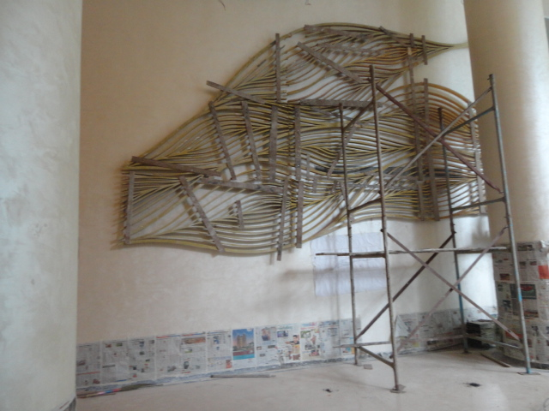
ERRECTION OF THE MURAL

Slide 11
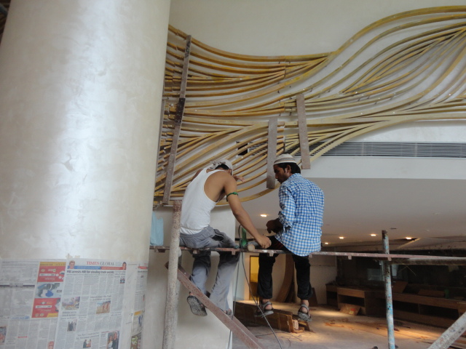
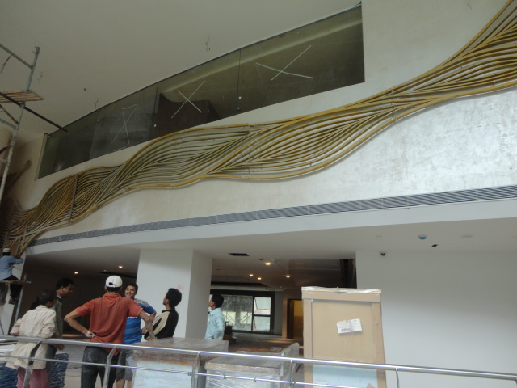
ERRECTION OF THE MURAL

Slide 12
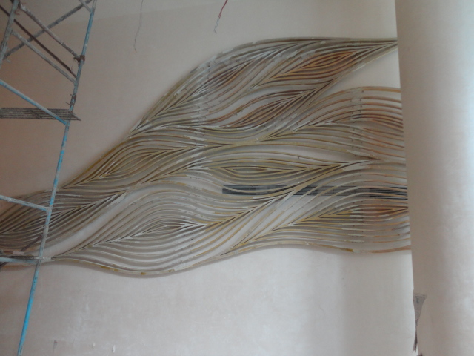
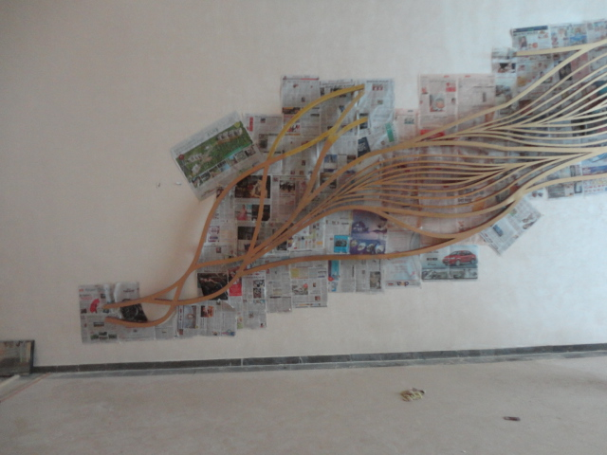
ERRECTION OF THE MURAL

Slide 13
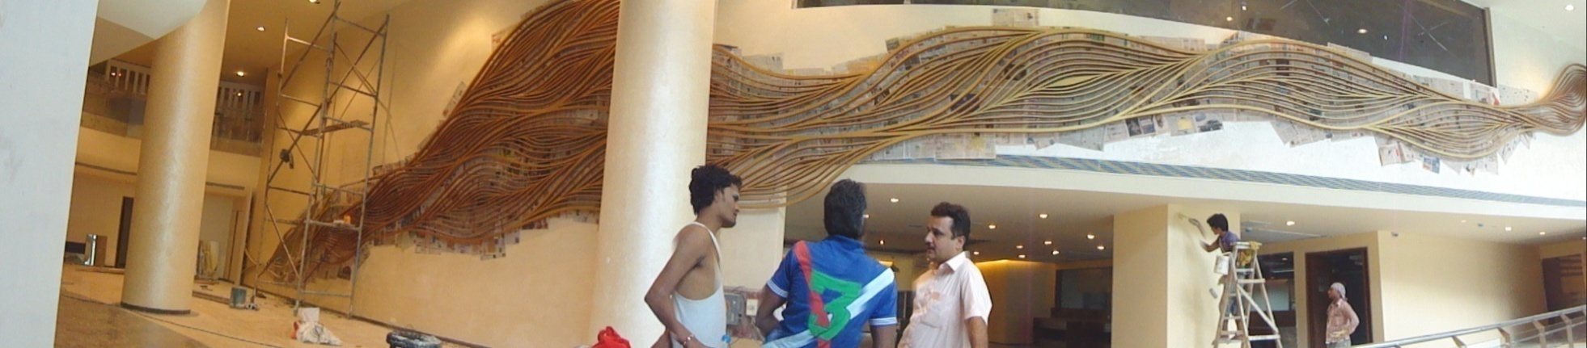
ERRECTION OF THE MURAL

Slide 14
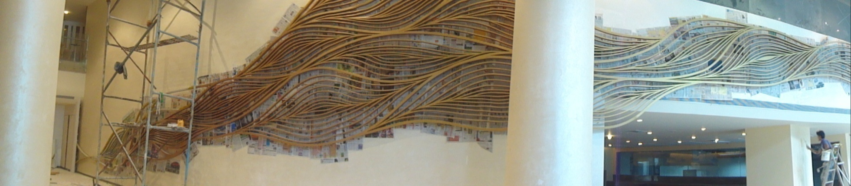
ERRECTION OF THE MURAL

Slide 15
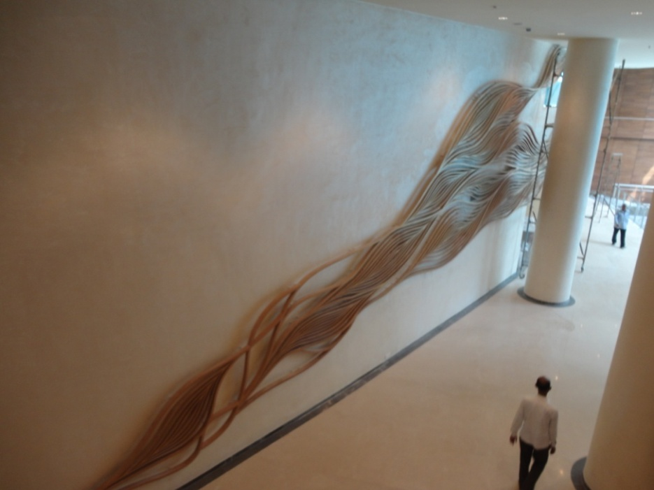
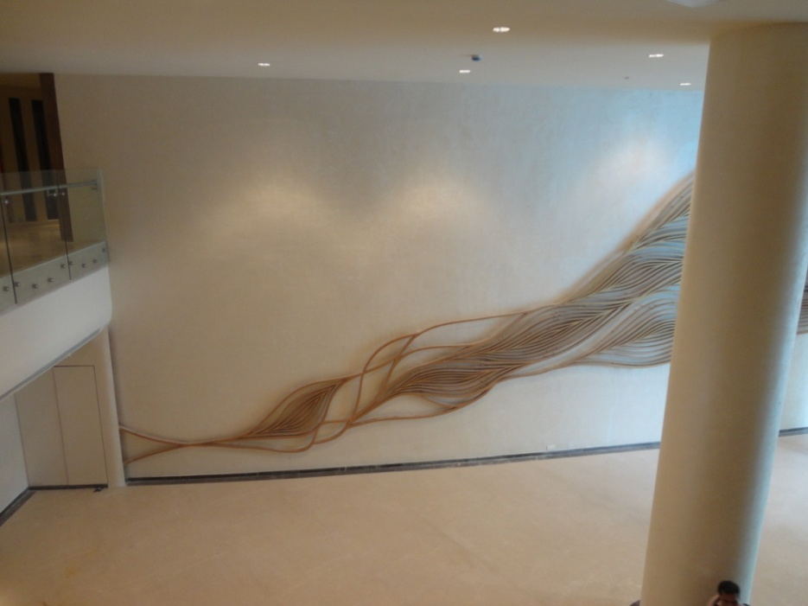
THE MURAL COMPLETE
IT’S NOT MONEY, IT’S SOMETHING CHALLENGEING TO BE CREATED

Slide 16
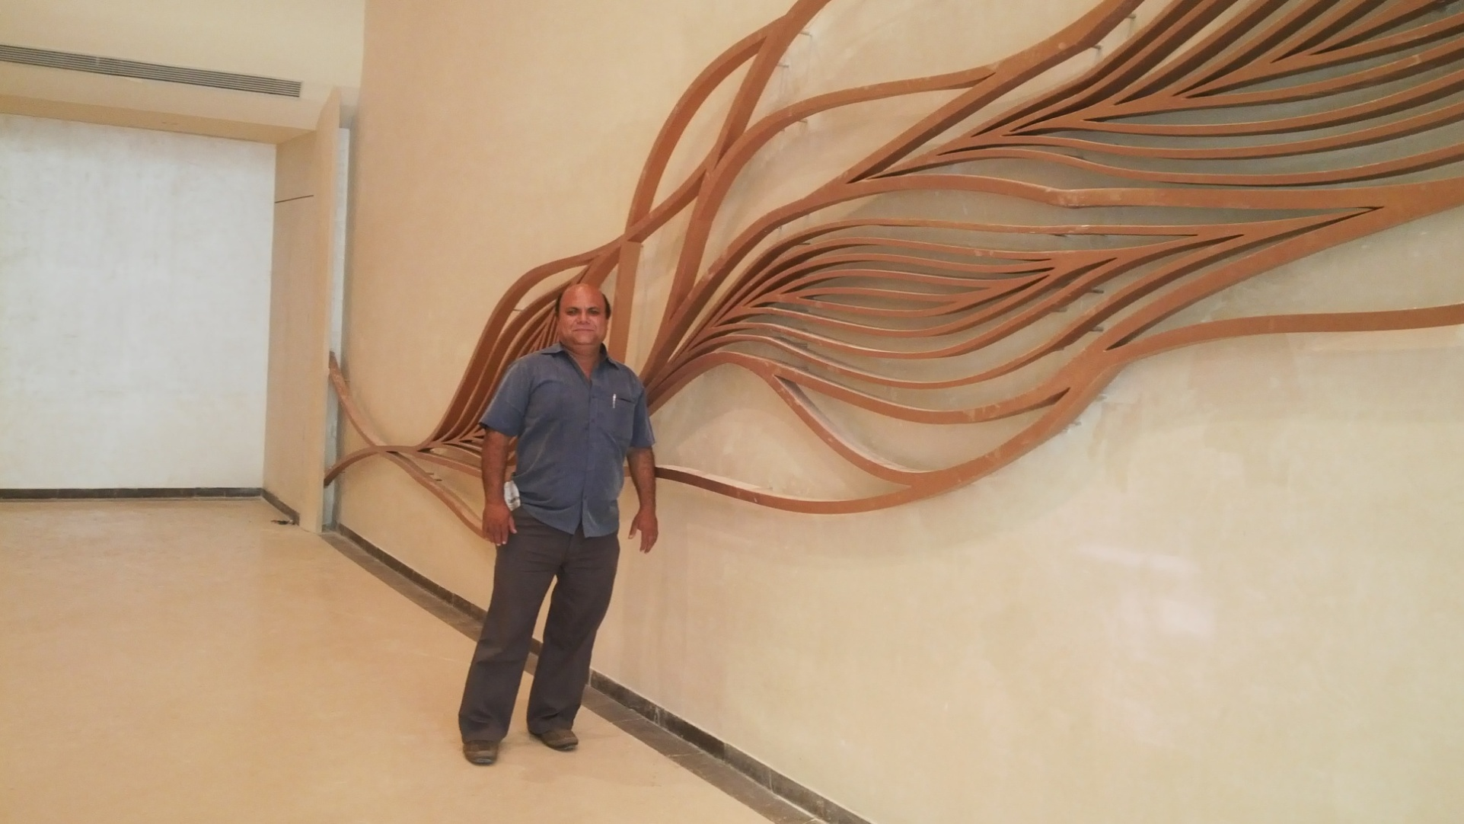
THE FINISHED ELEMENT
CHALLENGE ACCOMPLISHED – LEAVES US WITH A SMILE

Slide 17
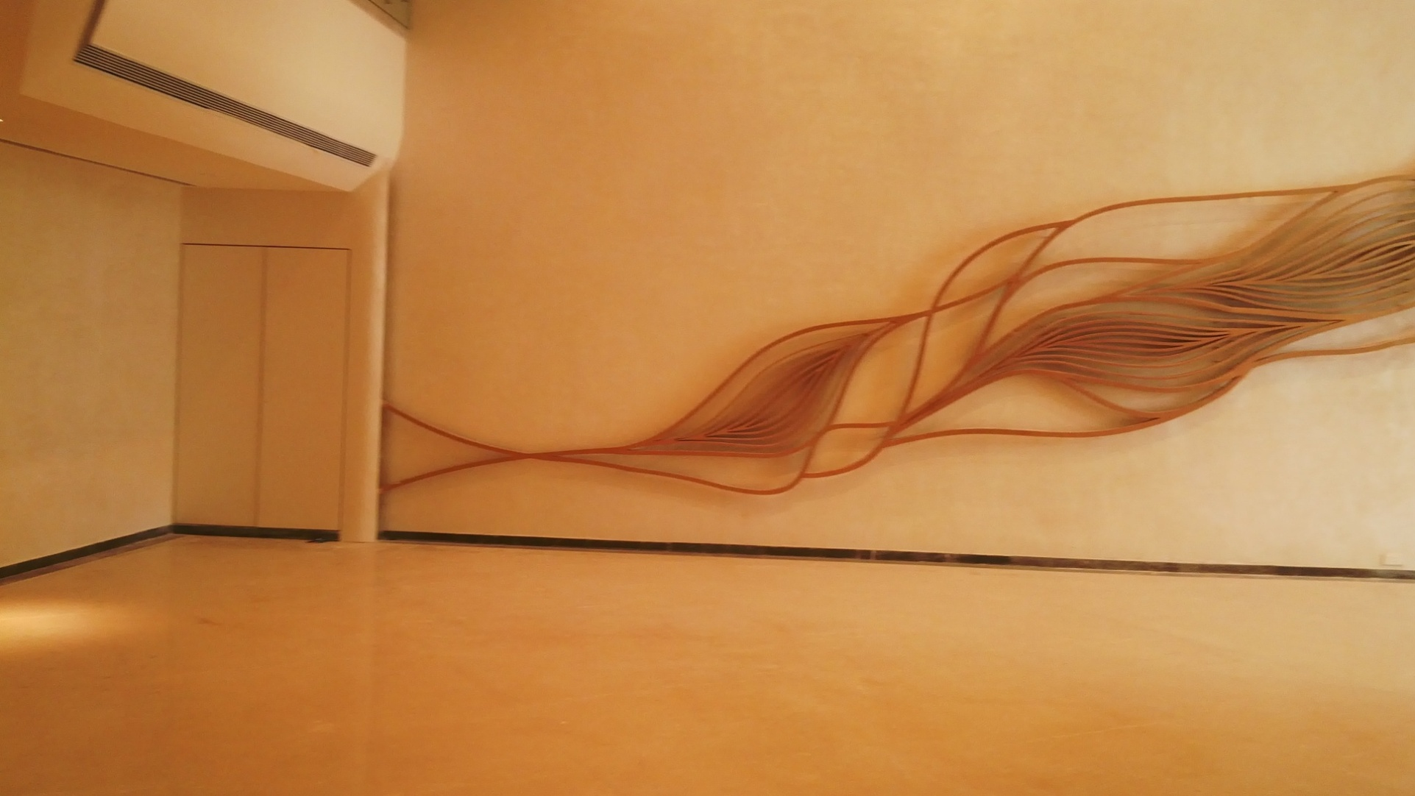
THE FINISHED ELEMENT

Slide 18
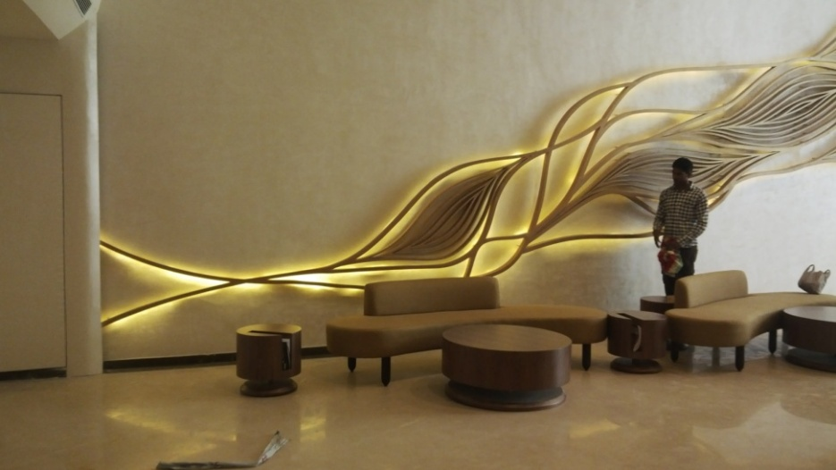
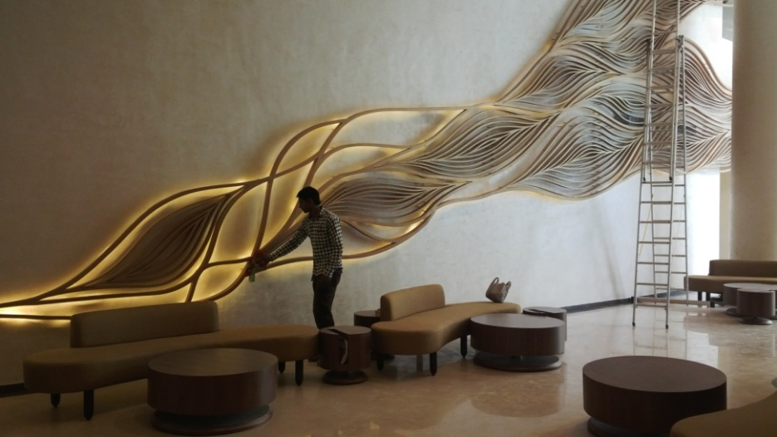
THE FINISHED ELEMENT
GOLDEN FINISH & BACK LIT

Slide 19
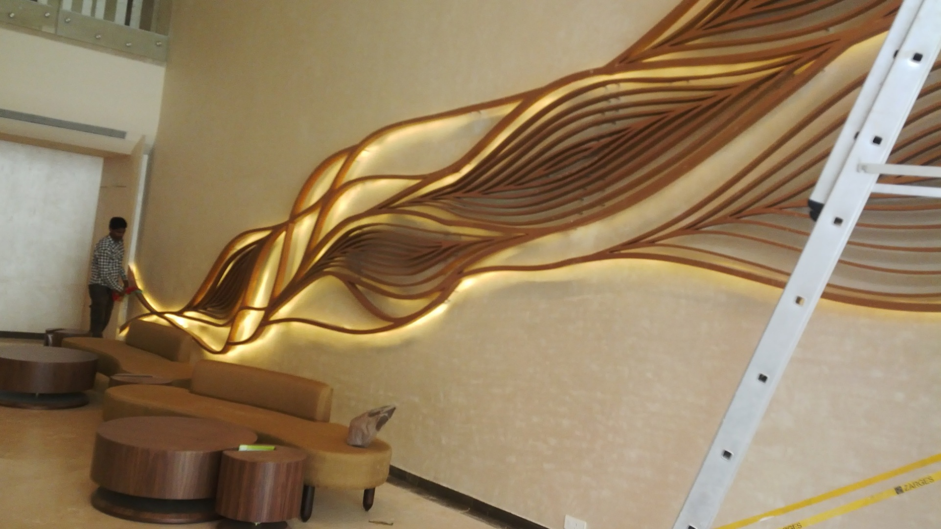
THE FINISHED ELEMENT
GOLDEN FINISH & BACK LIT

Slide 20
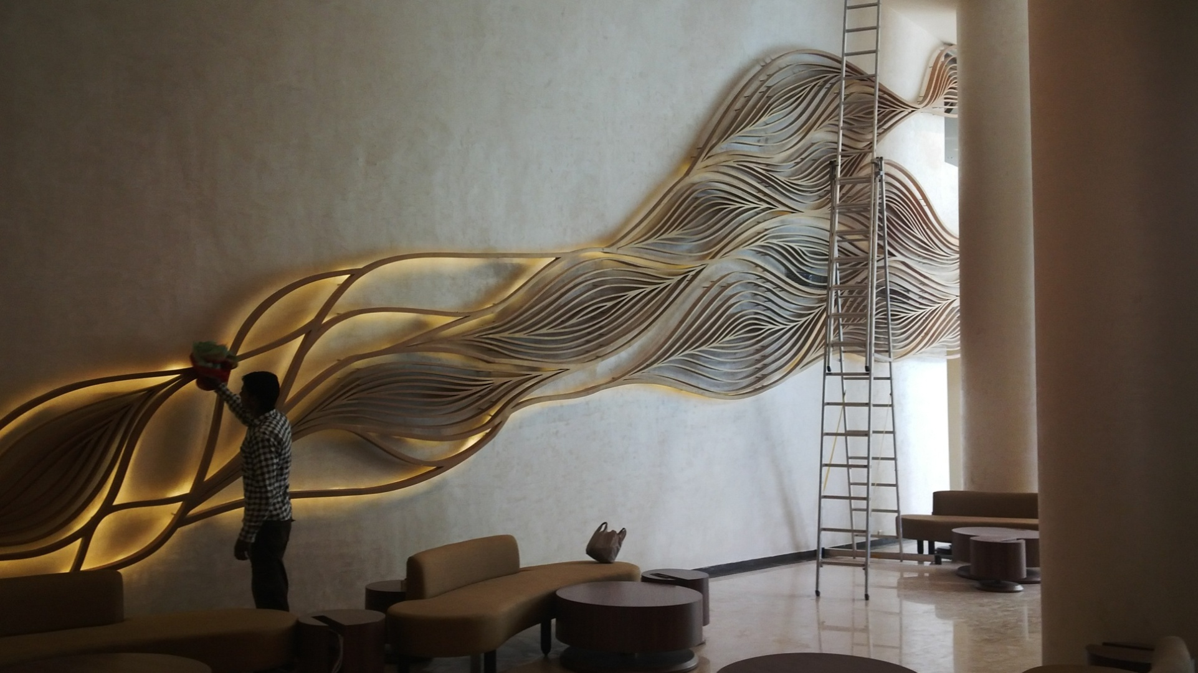
THE FINISHED ELEMENT
GOLDEN FINISH & BACK LIT

Slide 21
THE FINISHED ELEMENT
GOLDEN FINISH & BACK LIT

Slide 22
Contact details
GFRC FACADES.
GFRC / GRC, GRG CEILINGS & PANELS, FRP WORKS, HIGH END DECORATIVE & ARCHITECTURAL WORKS & ACOUSTIC SOLUTIONS WITH EXPERTISE IN HOME THEATRES
SRIHARI NILKAR
MUMBAI
Mobile: 09867569395
nilkarsrihari@gmail.com

